Slide 1
EE542 Lab 1
Sufyan Shaikh and Charlie Andre

Slide 2
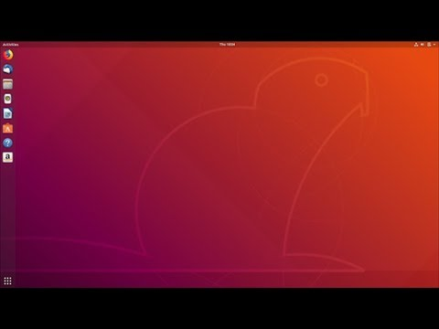
Part 1: Linux Installation (Dual Boot)
We both have macbooks so we followed this guide:
https://www.youtube.com/watch?v=kRgKlcm1XPI
Greg was pretty helpful!

Slide 3
Part 2: Single Connection Server and Client
The code for this part was given to us. The main purpose of this part of the lab is to understand the code and the process of establishing a socket on both the client side and server side.
After understanding the functionality of the code, compile it to get two executables, one for the server and the other for the client.
Obtain the IP address of the server machine, as the client will need it to connect to the server. (ip addr or ifconfig command for linux).
After you have done so, first on the computer that will act as the server, run the command,
./server [port no.], for example "./server 5000"
On the client side, run the command
./client [IP of server] [Port No.], for example "./client 192.168.1.150 5000".

Slide 4
Part 3: Multiple Connection Server and Client
To establish multiple connection server, little has to be done.
First, we find the accept statement in our original server code, and everything after it up until the close() statement, and cut it out of our code. Keep it handy as it will be used later.
In place of that code that was just cut, we will create an infinite while loop, so that the server continues to run, even after a connection has been made.
By having this while loop, we can call fork() to create a new process. This child process will close the socket and call a function we can call dostuff().
Now we can throw that code we cut earlier into the function called dostuff(), so that whenever a new connection is made, it acts the way it did with a single connection.
The parent process will now close the new socket and wait for a new connection, allowing for multiple connections.
Downside, the zombie problem. The processes are never actually killed, so we can fix this by adding a line of code to ignore the child process, allowing it to fully die.

Slide 5
Part 4: UDP Server and Client
The same as the TCP Server and Client except with a Datagram socket instead of a stream socket
Simple changes in the code need to be made.
Because the server is using the datagram socket, it does not use listen() or accept() system calls.
You also don’t have to connect to the client to the server. Instead you using sendto() and recvfrom() to characterize the relationship with the server

Slide 6
Part 5: Unix Server and Client
A socket in the Unix domain is the same as in the Internet domain, the only difference is the address.
In the file, un.h, the unix domain header, it can be noted that sun_path has the form of a path name, which leads to the conclusion that BOTH the client AND server NEED to be running on the same filesystem.

